Slide 1
Cyclistic case study
Presented by: Gokul raja
Last Updated: April 26,2023

Slide 2
Contents
Objective
Ride data analysis
Time of day wise
Weekday wise
Month wise
Bike type wise
Findings
Solutions
Next step

Slide 3
About the company
Cyclistic is a bike sharing company.
Operated at Chicago, USA.
5,824 bicycles in a network of 692 stations.
Geo tracked bicycles.
Offers Single ride pass,daily pass and annual memberships.

Slide 4
Objective
In order to convert casual users(daily pass/single ride pass) to cyclistic members(annual membership).
Assumption: Users with annual membership provides more revenue than casual users.

Slide 5
Challenge
How are Member users different from casual users.

Slide 6
Data
Data collected from April 2022 to March 2023 for the analysis.
Data provided by Motivate International Inc.
Source of the data is here.

Slide 7
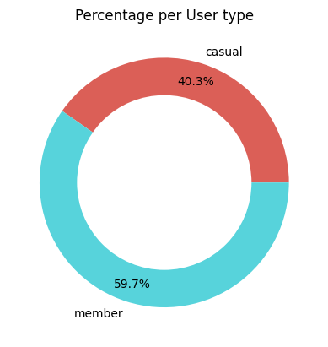
Who ride most?
Cyclistic members ride more than casual members.

Slide 8
Are more rides the reason for more revenue?
No, Average ride length contradicts that.

Slide 9
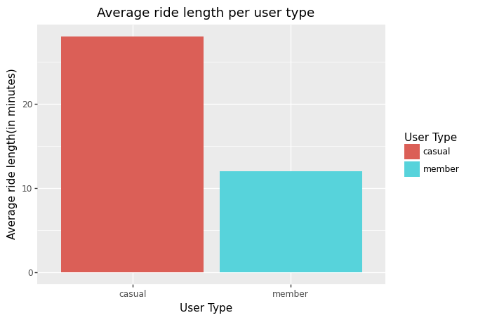
Casual users have x2 times ride length than Members

Slide 10
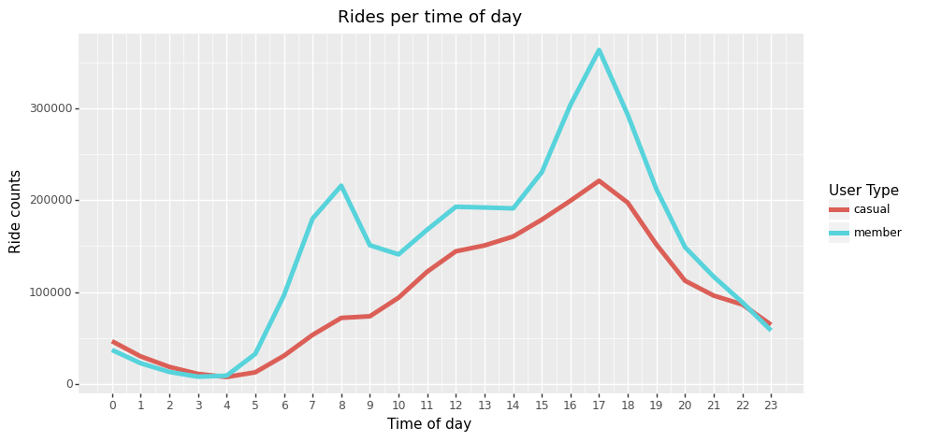
What about rides with respect to time?

Slide 11
Findings
Both riders have a steady increase from morning till evening and fall after that.
Cyclistic members have peak hours around morning(7 to 8) and evening(4-6).They may be using the bike to ride to work.

Slide 12
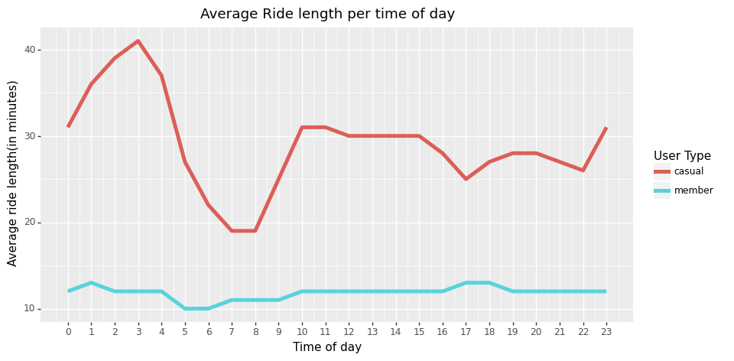
What about ride lengths with respect to time?

Slide 13
Findings
Cyclistic members have steady ride lengths throughout the day.
Interesting pattern in casual riders: Casual riders have long rides at midnight and short rides in early morning.

Slide 14
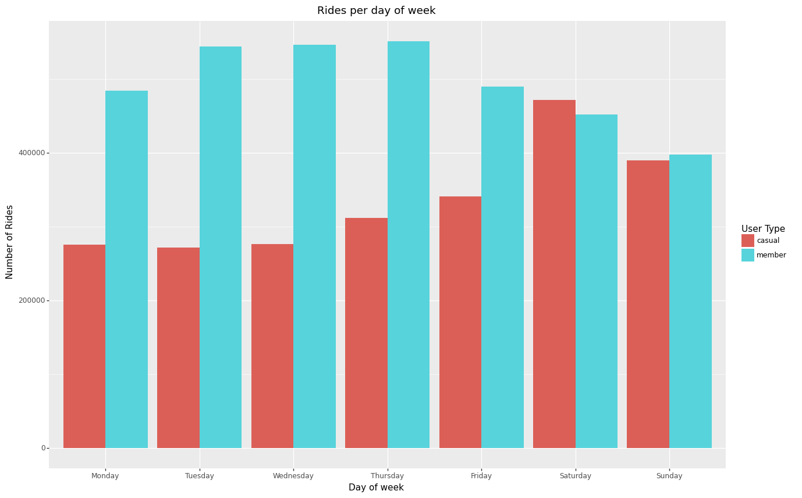
What about rides with respect to days of week?

Slide 15
Findings
In weekdays, Cyclistic members has more rides.
In weekends,both ride almost the same.

Slide 16
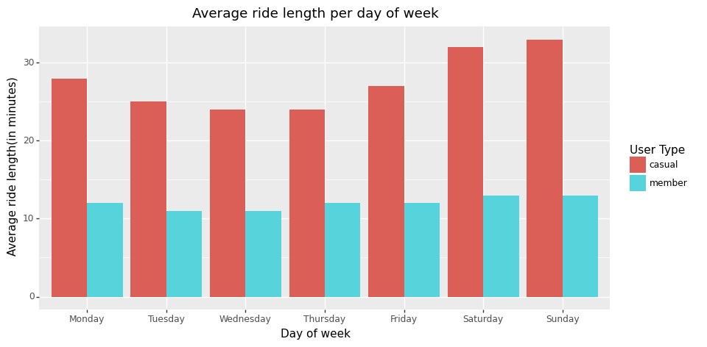
What about ride lengths with respect to day of week?

Slide 17
Findings
For Cyclistic members: Ride lengths are about the same throughout the week.
For casual riders: Ride lengths are high around weekends.

Slide 18
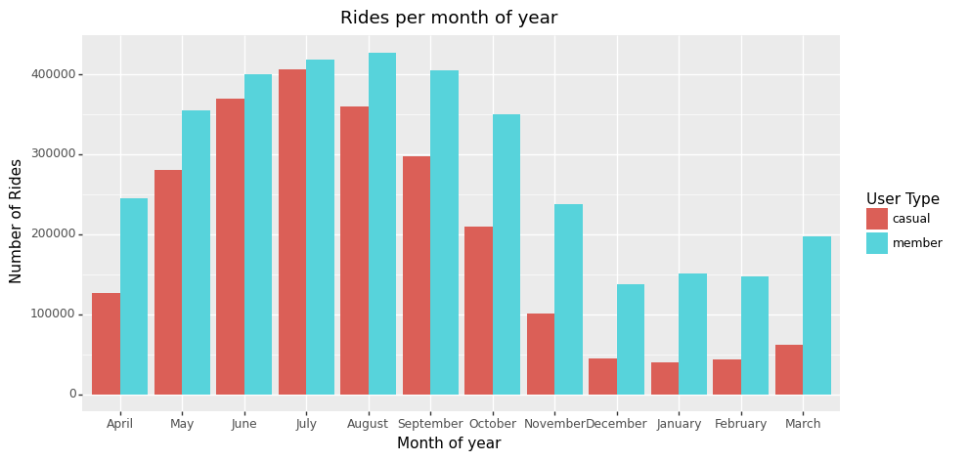
What about rides with respect to month of year?

Slide 19
Findings
Riders prefer to use bikes the most in the summer season.
We can see less rides in winter.

Slide 20
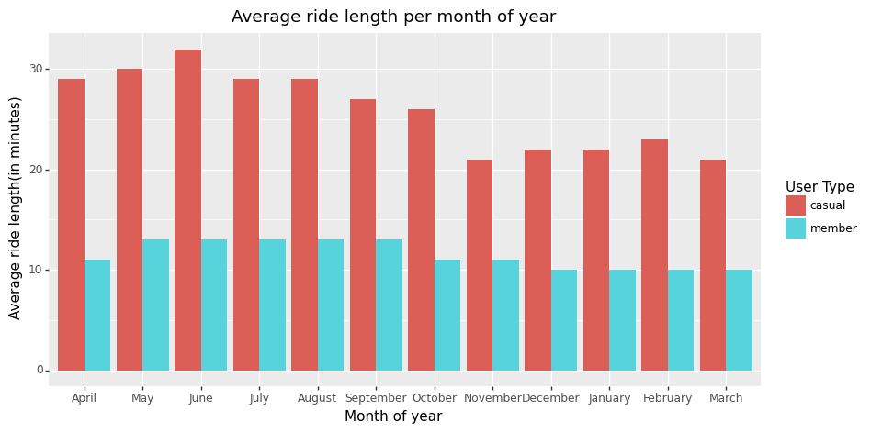
What about ride lengths with respect to month of year?

Slide 21
Findings
There are no concrete patterns.

Slide 22
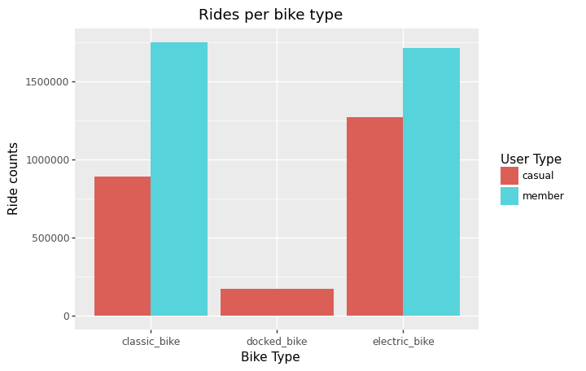
What about bike preferences?

Slide 23
Findings
Cyclistic member have not used docked bikes.
Casual riders prefer electric bikes.

Slide 24
how are members differ from causal rider?
Members riders have consistent ride lengths.
Members might be using bikes to ride to work*.
*need more information to confirm them.

Slide 25
How to convert casual users?
Offer discounts on summer and midnights(joy rides).
Offer weekend passes with reduced pricing.
Make availability of bikes during peak hours as members are using them.
We do not know any benefits of annual memberships.Add more benefits for annual memberships.
Educate people on environmental benefits of using bikes.
Show the health benefits of using regular bicycles.

Slide 26
Next steps
Path 1: Survey people of their economic and health data and their beliefs and collect more data and re evaluate the analysis.
Path 2: Create a advertising campaign about environmental and health benefits of bicycling and offer more benefits for annual membership compared to less frequent passes.

Slide 27
Thanks
Notes
Notebook used for cleaning data and creating visualizations is here.
Data used in the analysis is here.

